Slide 1
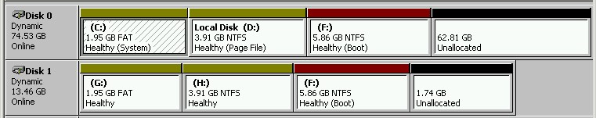
Storage Technologies
Telerik Software Academy
academy.telerik.com
Windows Basic and Dynamic Disk
Borislav Varadinov
Marian Marinov
System Administrator
CEO of 1H Ltd.
bobi@itp.bg
mm@1h.com

Slide 2

Table of Contents
MBR
Partition Table
Basic Disk
Dynamic Disk
Disk Management
Demonstration

Slide 3
Basic and Dynamic
Basic disks rely exclusively on the MBR-style partitioning scheme
Dynamic disks are partitioned using Logical Disk Manager (LDM)
Windows has the concept of basic and dynamic disks
Dynamic disks implement a more flexible partitioning scheme than that of basic disks

Slide 4
Basic Disk
Basic disks are the storage types most often used with Windows
Windows manages all disks as basic disks
Unless you manually create dynamic disks or convert existing basic disks to dynamic disks
Microsoft recommends to use basic disks
unless you require the multi-partition functionality of dynamic disks

Slide 5
Dynamic Disk
Introduced in Windows 2000 and available in all corporate successors versions
Dynamic disks and volumes rely on the Logical Disk Manager (LDM)
Provides ability to create multi-partition volumes:
Mirrored volumes
Spanned volumes
Striped volumes
RAID-5 volumes

Slide 6
Logical Disk Manager (LDM)
Similar technology to LVM in Linux
LDM uses database to track information
About dynamic volumes on the disk
And about other dynamic disks in the computer
Each dynamic disk in a computer stores a replica of the dynamic disk database

Slide 7
Management Tools
Disk Management snap-in (diskmgmt.msc)
Disk Management Command Line Utility (Diskpart.exe)

Slide 8
Live Demo
Managing basic disks and partitions
Create and delete primary and extended partitions
Create and delete logical drives within an extended partition
Managing dynamic disks and volumes
Create and delete simple, spanned, striped, mirrored, and RAID-5 volumes

Slide 9
Windows Drive Partitioning
http://academy.telerik.com

Slide 10




Free Trainings @ Telerik Academy
"Web Design with HTML 5, CSS 3 and JavaScript" course @ Telerik Academy
html5course.telerik.com
Telerik Software Academy
academy.telerik.com
Telerik Academy @ Facebook
facebook.com/TelerikAcademy
Telerik Software Academy Forums
forums.academy.telerik.com

